Slide 1
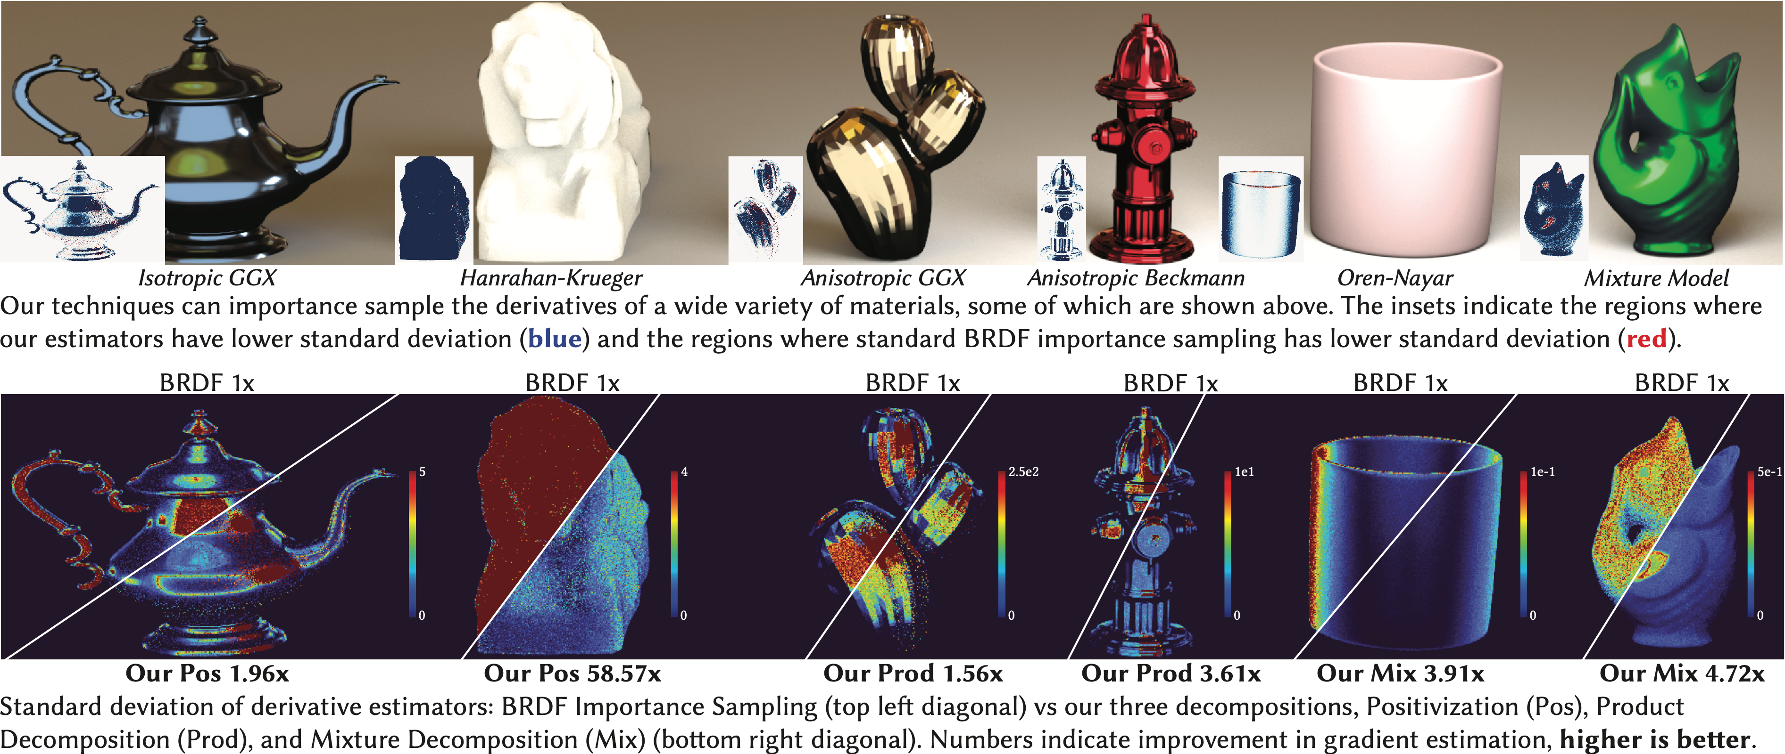
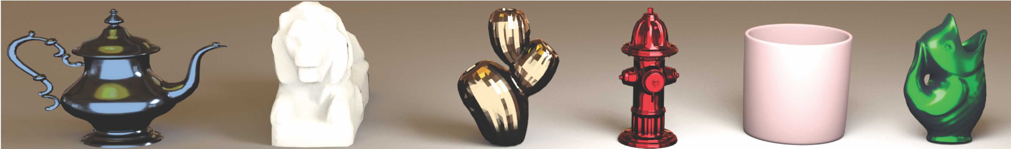


Importance Sampling BRDF Derivatives
above/below diagonal: baseline/ours
low variance
high variance
Variance reduction in differentiable rendering by correctly handling the derivative’s sign
Yash Belhe, Bing Xu, Sai Praveen Bangaru*, Ravi Ramamoorthi, Tzu-Mao Li — UCSD (*MIT)
Notes:
Hi, I’m excited to talk to you about how you can better estimate the derivatives of several BRDFs by paying careful attention to their sign.
I’d like to thank my wonderful co-authors Bing and Sai and my advisors Ravi and Tzu-Mao for all their help and guidance.

Slide 2
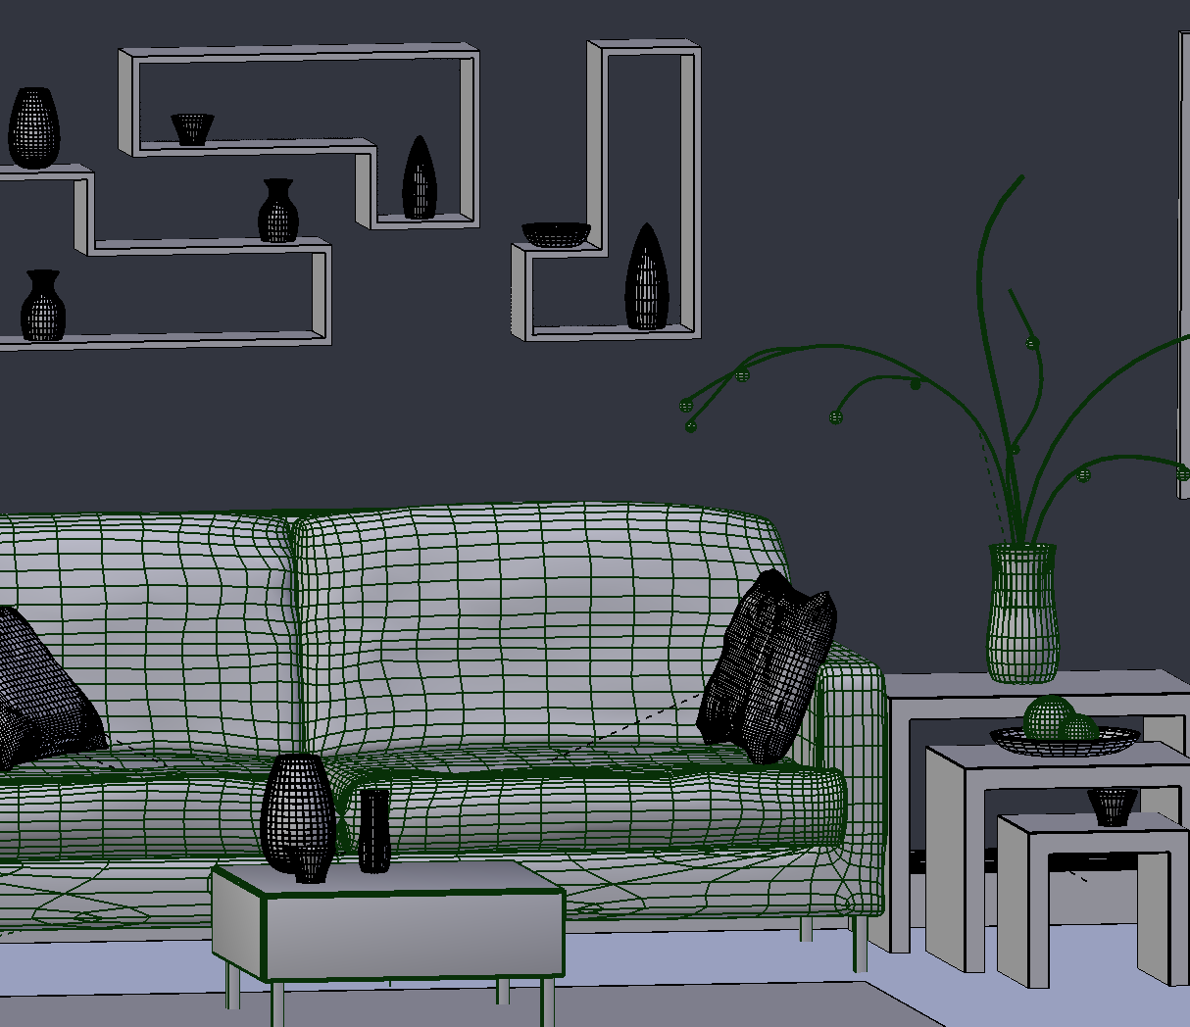


Inverse rendering via derivatives of images
update
3D scene:
triangle positions
camera pose
materials
…
image
∇ loss
target
slide credit: Tzu-Mao Li
Notes:
Let’s briefly talk about why derivative quality matters.
In inverse optimization we update 3D scene parameters based on their derivative with respect to a loss — therefore, higher quality BRDF derivatives lead to higher quality material recovery in fewer iterations.

Slide 3
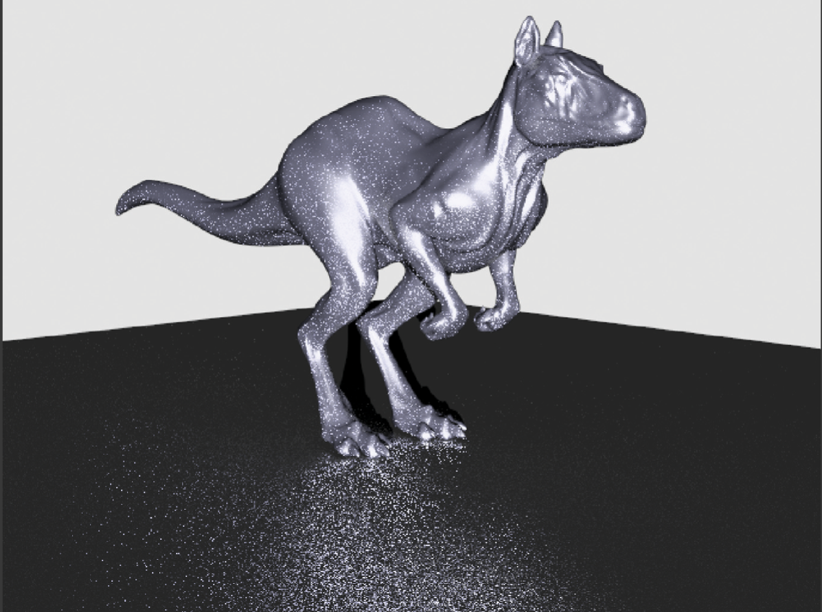
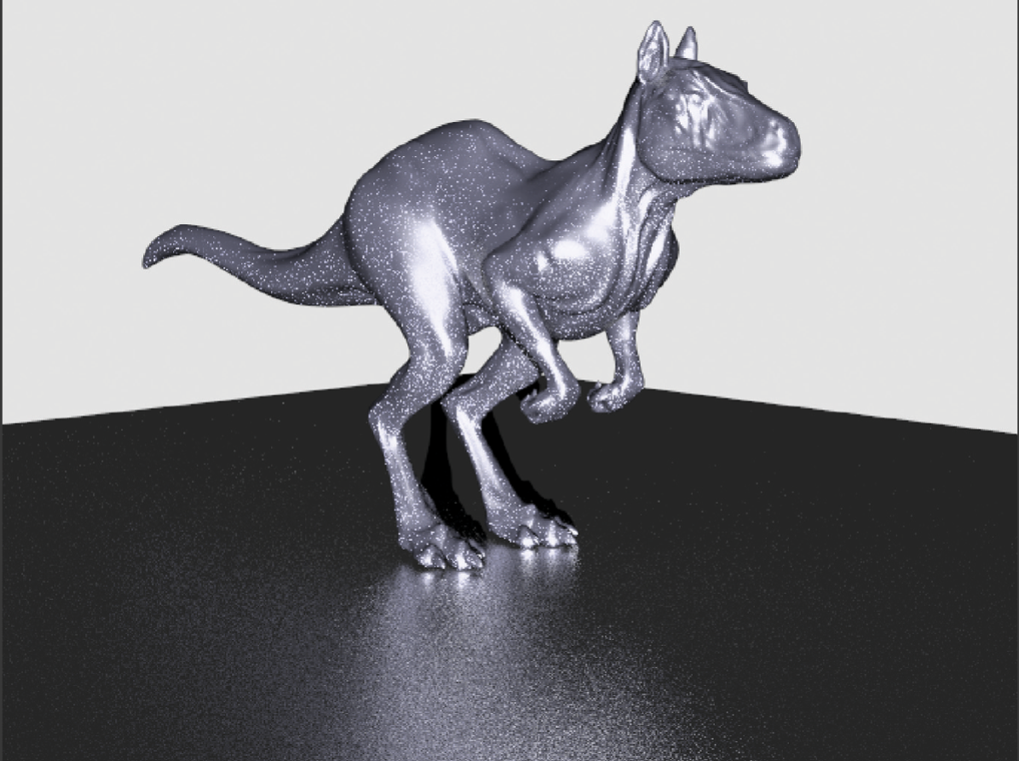
BRDF importance sampling is important in forward rendering
Uniform Sampling
BRDF Importance Sampling
image credit: PBRT - Pharr, Jakob and Humphreys
Notes:
In forward rendering, all we know how crucial BRDF importance sampling is toward variance reduction — in this work, we aim to bring it to differentiable rendering.

Slide 4
Goal: low-variance importance sampling of BRDF derivatives
Notes:
More concretely, our goal is build low-variance importance sampling techniques for a wide range of popular BRDFs derivatives

Slide 5
Goal: low-variance importance sampling of BRDF derivatives
Notes:
Here’s just a few of the analytic BRDFs whose derivatives we support

Slide 6
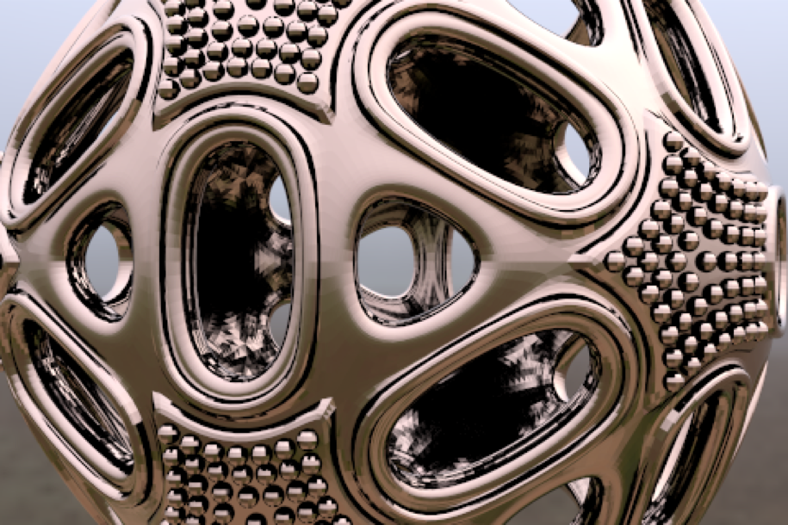

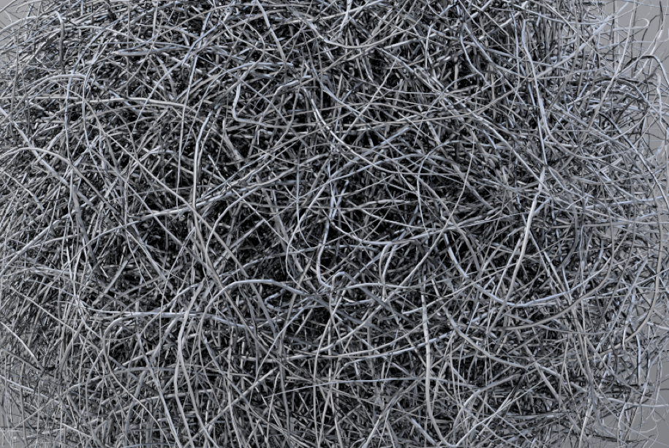
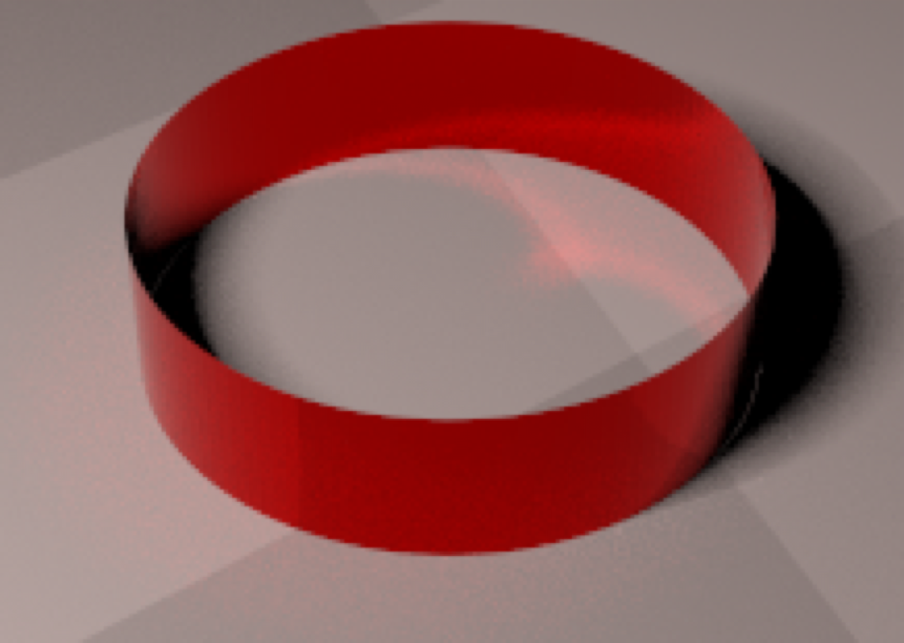
Goal: low-variance importance sampling of BRDF derivatives
Direct Illumination
Glossy Reflection
Complex Visibility
Caustics
Notes:
Additionally our techniques are robust under complex light transport phenomena.

Slide 7

What do BRDF derivatives look like?
500 samples per pixel
Notes:
To build importance sampling techniques for BRDF derivatives, let’s first get a feel for them
Here’s an example of a path-traced image rendered at 500 samples per pixel

Slide 8
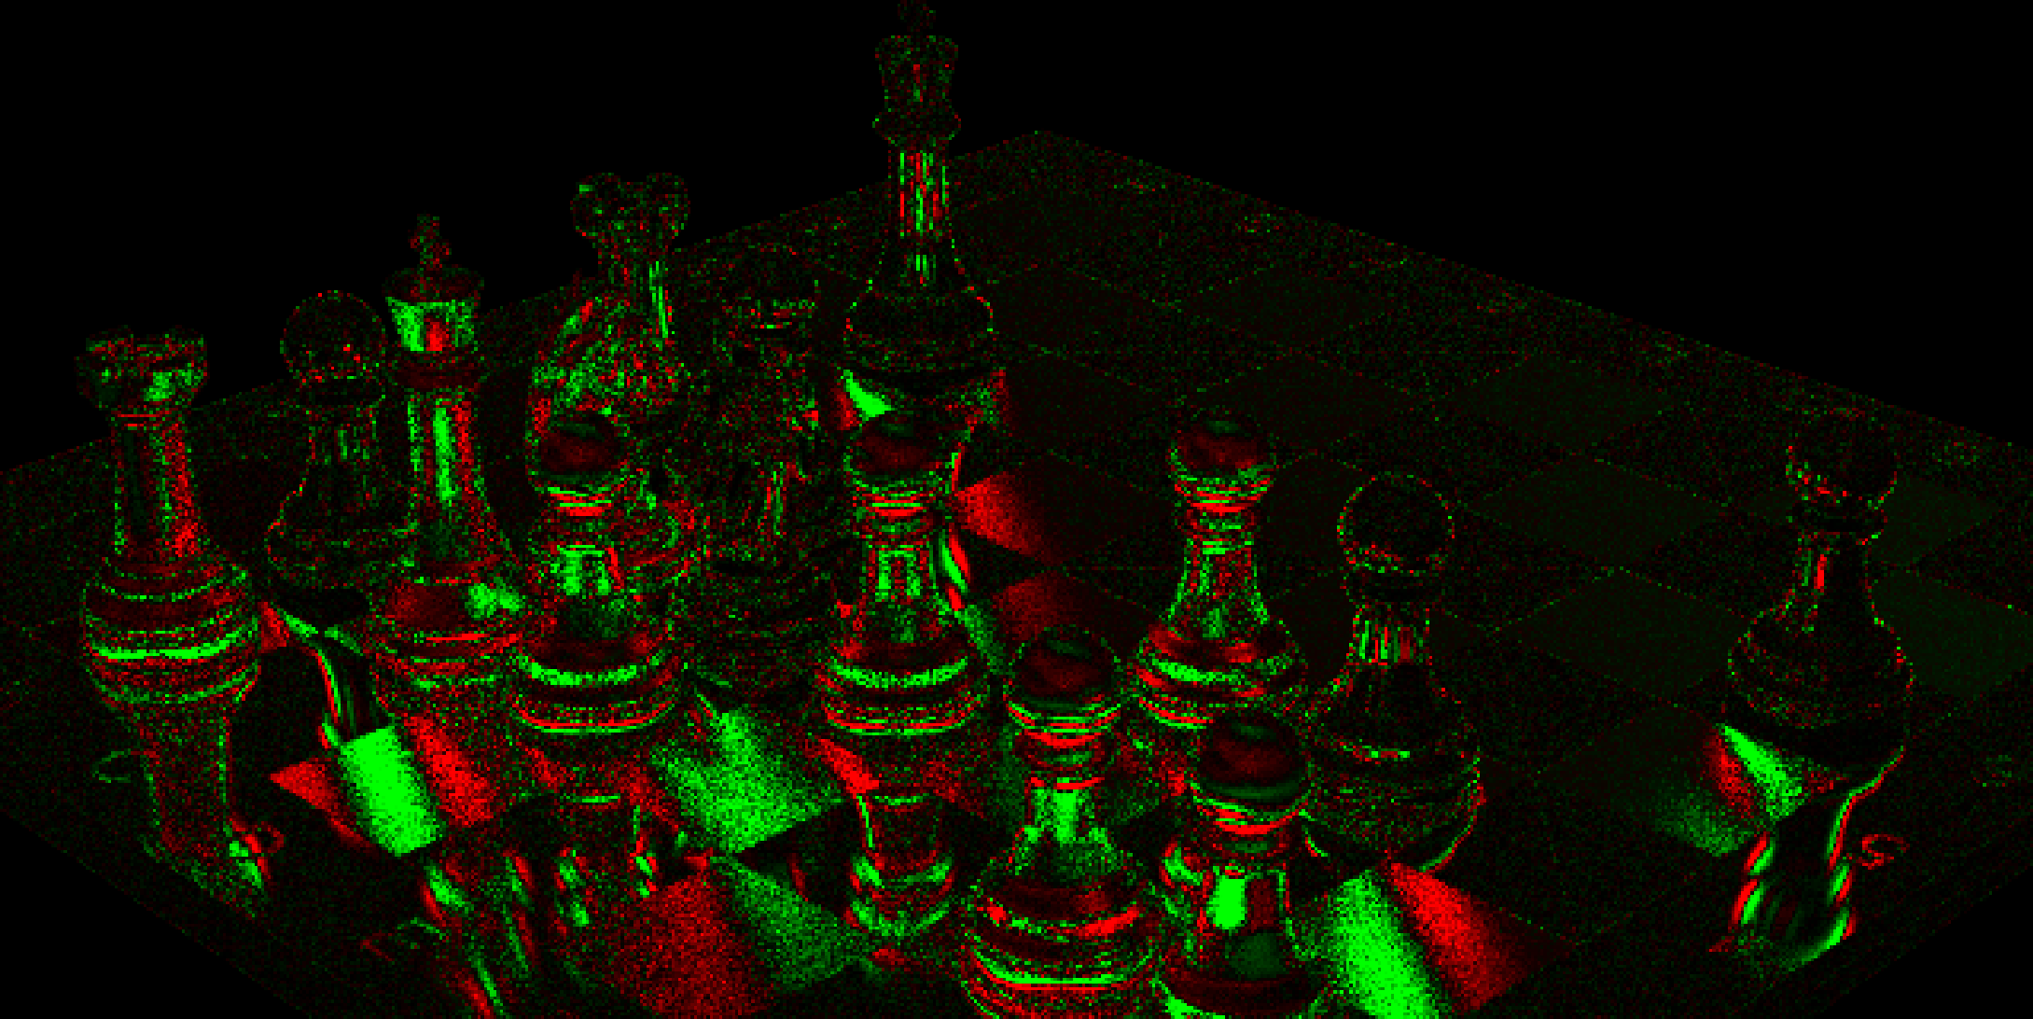
BRDF derivatives can take both positive and negative values
Notes:
Differentiating it with respect to the roughness of the material produces the derivative image above.
Notice how the derivative can take both positive and negative values — this is fundamentally different from forward rendering, where all quantities are strictly non-negative — the negative values are a new source of variance in differentiable rendering.

Slide 9
BRDF derivatives can take both positive and negative values
10,000 samples per pixel
Notes:
What’s more is that the derivative image was rendered using 10,000 samples per pixel — significantly more than the 500 samples that forward rendering took.

Slide 10
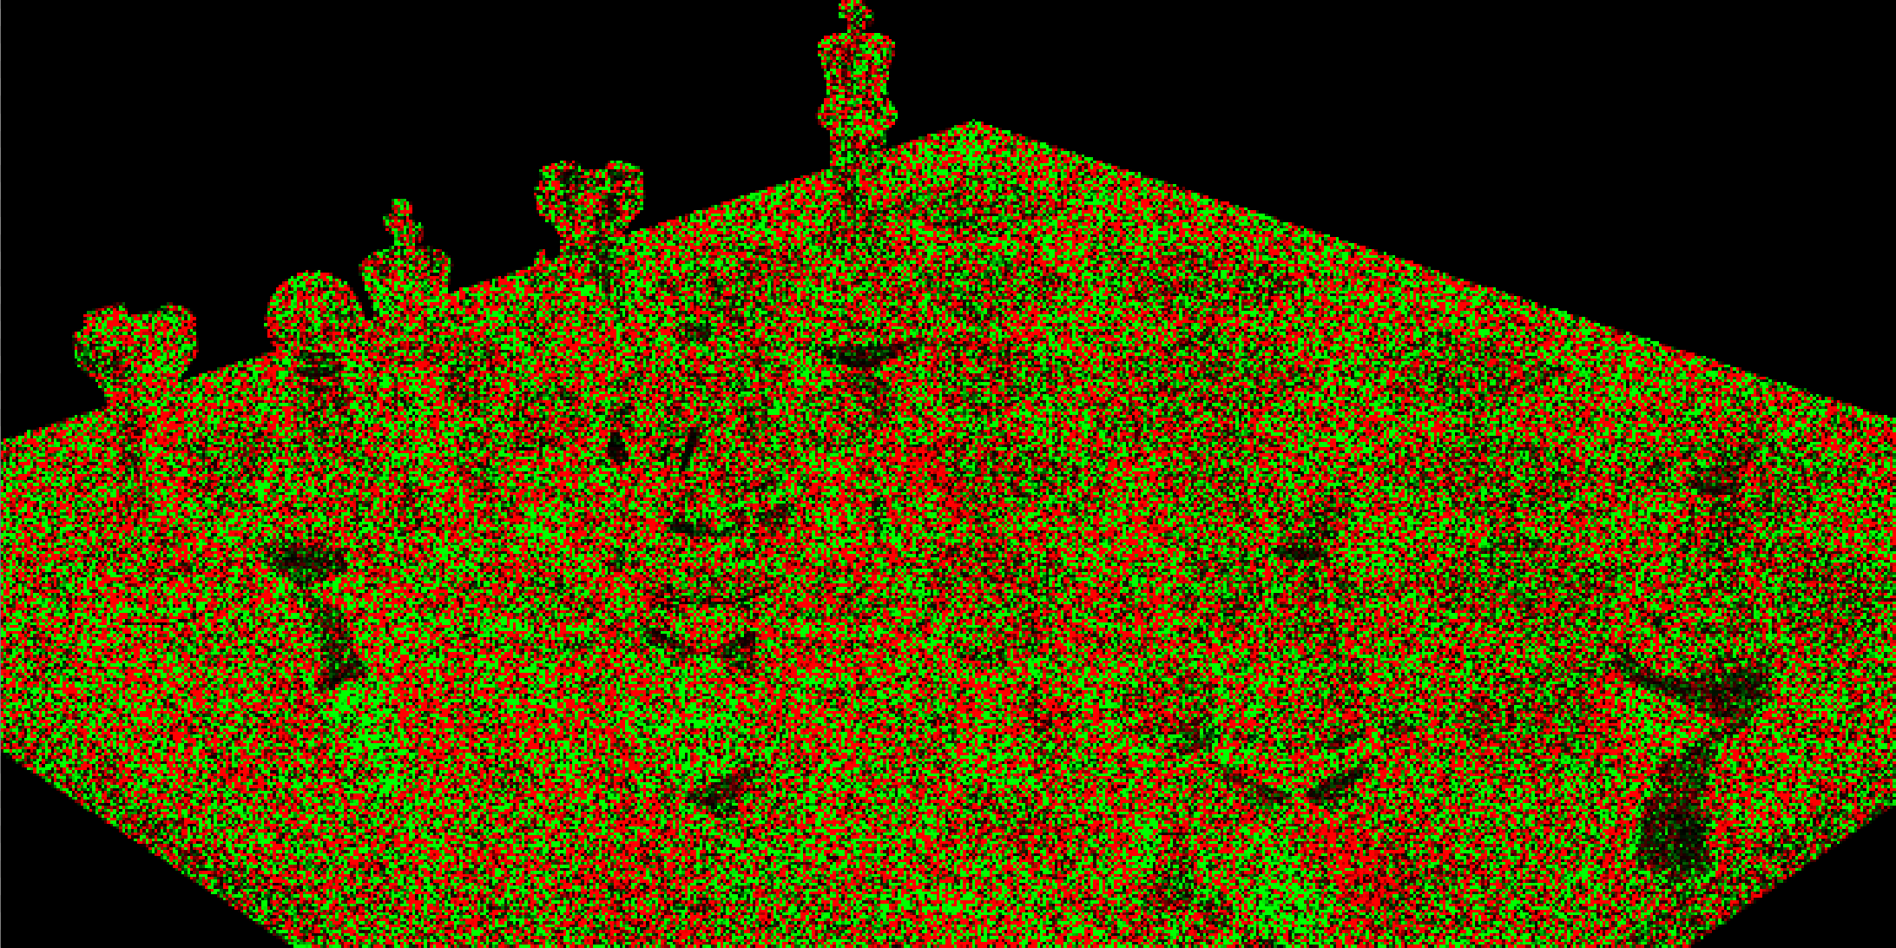
BRDF derivatives can be very noisy
100 samples per pixel
Notes:
With fewer samples, the derivative is extremely noisy — it even has the wrong sign in several location which can cause optimization to diverge.
One of the main reasons for this is terrible importance sampling of the derivative. To fix this, first recall how BRDF importance sampling works in forward rendering.

Slide 11
Importance sampling PDF (p) BRDF (g)
$$∝$$
$$g$$
Notes:
In BRDF importance sampling, we’re given a BRDF g,

Slide 12
Importance sampling PDF (p) BRDF (g)
$$∝$$
$$g$$
$$p$$
Notes:
And our goal is to construct a PDF p that is proportional to it.

Slide 13
Importance sampling PDF (p) BRDF (g)
$$∝$$
$$g$$
$$p$$
$$g/p$$
Notes:
If we’re able to construct this PDF and a sampling routine for it — the resulting estimator has 0 variance, since the ratio g/p is constant.

Slide 14
Same PDF to importance sample BRDF derivative?
$$g$$
$$p$$
Notes:
Naturally, you might wonder — can’t we just use the same PDF to importance sample BRDF derivatives?

Slide 15
BRDF is very different from its derivative
$$f$$
$$g$$
$$g$$
$$f$$
$$p$$
Zeltner et al: Monte Carlo Estimators for Differential Light Transport
Notes:
Unfortunately, that won’t work very well
Just take a look at BRDF derivative f — in general, it can be very different from g.
Therefore, the ratio f/p will be nowhere close to constant, leading to high variance.

Slide 16
We can construct p |f|?
$$∝$$
$$f$$
$$p$$
Notes:
Unfortunately, we can’t construct a PDF proportional to f since f takes both positive and negative values.
So let’s do the next best thing and construct a PDF p proportional to the absolute value of f.
Unfortunately, there’s another problem here

Slide 17
p |f| has sign variance
$$∝$$
$$f$$
$$f/p$$
$$p$$
Notes:
The ratio f/p is no longer constant due to sign changes — these sign changes introduce sign variance which can be quite troublesome.
At the crux of all our importance sampling techniques is correctly handling this sign variance.

Slide 18
Key Idea: decompose real-valued into sum of positive and negative
$$f$$
precisely the decomposition is non-negative and non-positive
Notes:
We do this by decomposing the real-valued f into the sum of fully positive and negative parts.
In this talk I’ll talk about 3 different decompositions to do this — the first one is positivization.

Slide 19
Key Idea: decompose real-valued into sum of positive and negative
$$f^{+}$$
$$f$$
$$+$$
$$=$$
$$f^{-}$$
Notes:
Positivization decomposes f by computing its min and max around 0

Slide 20
Positivization — Owen and Zhou 2000.
$$f$$
$$=$$
$$f^{+}$$
$$+$$
$$f^{-}$$
$$p^{+}$$
$$f^{+}$$
$$p^{-}$$
$$f^{-}$$
$$∝$$
$$∝$$
Notes:
It was first introduced by Owen and Zhou — we bring it to differentiable rendering.
Since there are no sign changes within each part f+ and f-, we can we importance sample them separately using PDFs p+ and p-

Slide 21
Positivization — Owen and Zhou 2000.
$$f$$
$$=$$
$$f^{+}$$
$$p^{-}$$
$$+$$
$$p^{+}$$
$$f^{-}$$
$$p^{+}$$
$$f^{+}$$
$$p^{-}$$
$$f^{-}$$
$$∝$$
$$∝$$
Notes:
Which look something like this.

Slide 22
Positivization — Owen and Zhou 2000.
$$f$$
$$=$$
$$f^{+}$$
$${f^{+}}/{p^{+}}$$
$$p^{-}$$
$$+$$
$$p^{+}$$
$${f^{-}}/{p^{-}}$$
$$f^{-}$$
$$p^{+}$$
$$f^{+}$$
$$p^{-}$$
$$f^{-}$$
$$∝$$
$$∝$$
Notes:
Now, the ratio of f/p for each of the terms is constant — so they’ll both have zero variance
This is awesome, since this is exactly what we were after!
Let’s see an example of positivization in action.

Slide 23
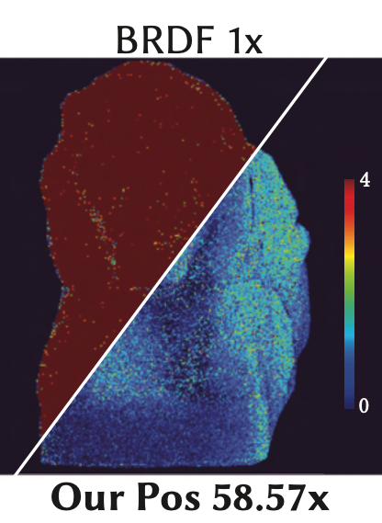
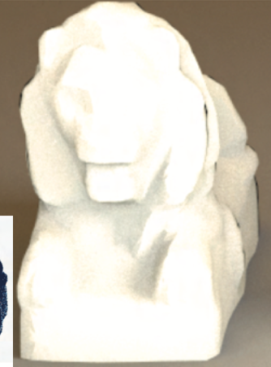
Positivization reduces variance by 58x!
Forward rendering
Variance
Notes:
In this example positivization results in 58 times lesser variance than BRDF importance sampling when estimating a derivative of the Hanrahan-Krueger BRDF.
The variance images are shown on the right, brighter regions in red have higher variance and cooler regions in blue have lower variance.
Using BRDF importance sampling to estimate the derivative neglects the fact that the BRDF and its derivative look very different.
It also doesn’t account for the sign changes in the derivative.
This is why positivization which accounts for both of these effects has much lower variance.

Slide 24
Positivization is applicable to several BRDF derivatives
Roughness of isotropic GGX, Beckmann
Exponent of Blinn-Phong
Scattering parameter of Hanrahan-Krueger BRDF
Notes:
So far, we’ve found that positivization can be applied to several popular BRDF derivatives, some of which are listed above.

Slide 25



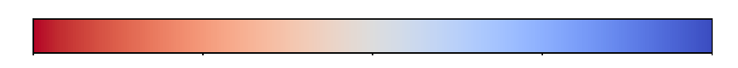
Positivization requires analytic root locations
$$f$$
$$f^{-}$$
$$f^{+}$$
$$ϕ$$
$$=$$
$$+$$
$$θ$$
$$-$$
$$0$$
$$+$$
Notes:
Unfortunately, positivization isn’t a silver bullet, it can’t simply be applied to all derivatives — let’s see why.
To apply positivization, we need to find the derivative f’s roots which is needed to separate it into its positive and negative parts.

Slide 26
Positivization requires analytic integrability
$$c^{-}p^{-}(θ,ϕ)=f^{-}(θ,ϕ)$$
$$∫$$
$$f^{-}(θ,ϕ)$$
$$c^{-}=$$
Notes:
Following this, we need to compute the PDF’s normalization constant which involves analytically integrating the positive and negative parts separately

Slide 27
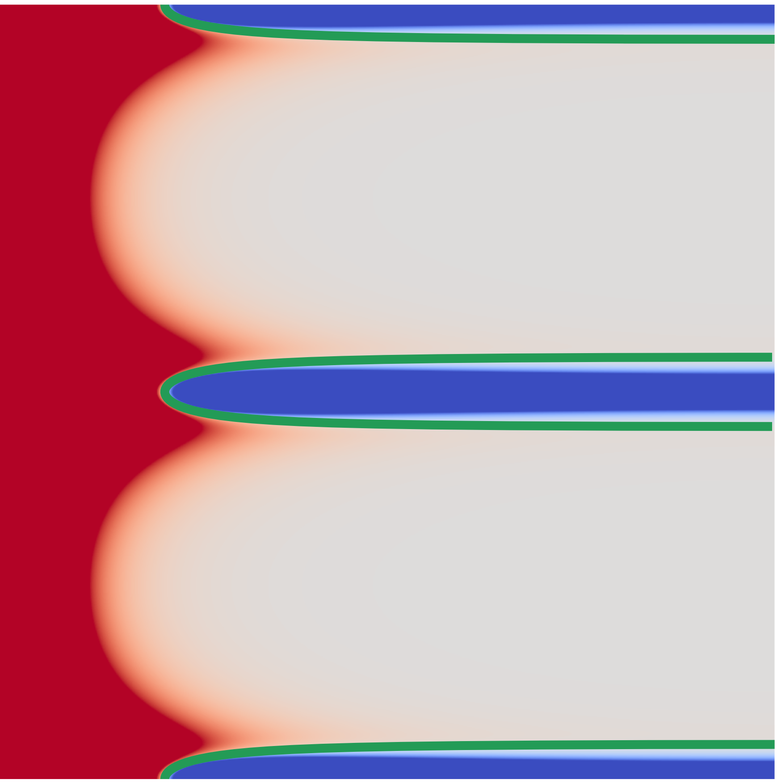
No analytic root locations — no positivization :(
Notes:
Here’s an example of the derivative of an anisotropic GGX BRDF. Notice how the roots no longer lie along a simple straight line. For several BRDFs we can’t analytically solve for these roots.

Slide 28

No analytic integrability — no positivization :(
$$f^{-}(θ,ϕ)$$
$$∫$$
$$c^{-}=$$
Notes:
Even if we can like in this example, positivization still fails because the normalization constant can’t be computed in closed form due to the complicated nature of the roots.

Slide 29
Positivization is inapplicable to several BRDF derivatives :(
Directional roughness of anisotropic Beckmann and GGX
Directional exponent of Ashikhmin-Shirley
Width of Burley’s BSSRDF
Weights of mixture BRDFs
All layered BRDFs (Disney Principled, Autodesk Standard Surface, etc.)
Oren-Nayar
Microcylinder BRDF
and many others…
Notes:
Unfortunately, there’s a long list of BRDF derivatives that just can’t be positivized.

Slide 30
Our product and mixture decomposition can handle these!
Directional roughness of anisotropic Beckmann and GGX
Directional exponent of Ashikhmin-Shirley
Width of Burley’s BSSRDF
Weights of mixture BRDFs
All layered BRDFs (Disney Principled, Autodesk Standard Surface, etc.)
Oren-Nayar
Microcylinder BRDF
and many others…
Product decomposition
Mixture decomposition
Notes:
I’ll now talk about our two new techniques — product and mixture decomposition that can handle all the derivatives from the previous slide — that positivization couldn’t!

Slide 31
Key idea: let positive and negative parts overlap!
Notes:
Both of these techniques also split up the derivative into a positive and a negative part — but the big difference is that they allow these parts to overlap!

Slide 32
Recall: Positivization has non-overlapping support
$$f^{+}$$
$$f$$
$$+$$
$$=$$
$$f^{-}$$
Notes:
Recall that oositivization produces positive and negative parts which have non-overlapping support.
But this is by no-means a requirement — all we need is that f+ and f- add up to f

Slide 33
A decomposition with overlapping support
$$f^{+}$$
$$f$$
$$+$$
$$=$$
$$f^{-}$$
Notes:
Which means that this decomposition with overlapping support is totally valid too since f+ and f- add up to f

Slide 34
Another decomposition with overlapping support
$$f^{+}$$
$$f$$
$$+$$
$$=$$
$$f^{-}$$
Notes:
But there’s nothing unique about the previous decomposition — here’s another valid decomposition.
In fact, there are many possible decompositions just like these — but how do we find them?
To do this, we’ll rely on some analytic properties of BRDF derivatives. Let’s start with the mixture decomposition.

Slide 35
Our Mixture Decomposition
$$g=βg_{s}+(1-β)g_{d}$$
Notes:
Our mixture decomposition handles the derivatives of mixture models with respect to the mixture weight.
Here, the mixture BRDF, g, is a linear combination of a specular component g_s and a diffuse component g_d.

Slide 36
Our Mixture Decomposition
$$g=βg_{s}+(1-β)g_{d}$$
$$∂_{β}g=f=g_{s}-g_{d}$$
Notes:
Its derivative with the mixture weight, f, is a difference between the two components.

Slide 37
Our Mixture Decomposition
$$g=βg_{s}+(1-β)g_{d}$$
$$∂_{β}g=f=g_{s}-g_{d}$$
$$f$$
Notes:
And this is what it might look like

Slide 38
Our Mixture Decomposition
$$g=βg_{s}+(1-β)g_{d}$$
$$∂_{β}g=f=g_{s}-g_{d}$$
$$f$$
Notes:
For general specular and diffuse components, it is hard to find the roots in closed form — this makes positivization inapplicable here.

Slide 39
Our Mixture Decomposition
$$g=βg_{s}+(1-β)g_{d}$$
$$∂_{β}g=f=g_{s}-g_{d}$$
$$f$$
Notes:
However, if we plot the two terms of the derivative separately, we see something really interesting!!

Slide 40
Our Mixture Decomposition
$$g=βg_{s}+(1-β)g_{d}$$
$$∂_{β}g=f=g_{s}-g_{d}$$
$$g_{s}$$
$$f$$
$$-g_{d}$$
Notes:
g_s is all positive and -g_d is all negative — this is to be expected since they’re both non-negative BRDFs themselves

Slide 41
Our Mixture Decomposition
$$g_{s}$$
$$g=βg_{s}+(1-β)g_{d}$$
$$∂_{β}g=f=g_{s}-g_{d}$$
$$f$$
$$+$$
$$=$$
$$-g_{d}$$
Notes:
Now, we can just separate the two terms

Slide 42
Our Mixture Decomposition
$$g_{s}$$
$$g=βg_{s}+(1-β)g_{d}$$
$$p_{s}$$
$$∂_{β}g=f=g_{s}-g_{d}$$
$$f$$
$$+$$
$$=$$
$$p_{d}$$
$$-g_{d}$$
Notes:
And importance sample them individually — which gives us our mixture decomposition.
Let’s see some results

Slide 43
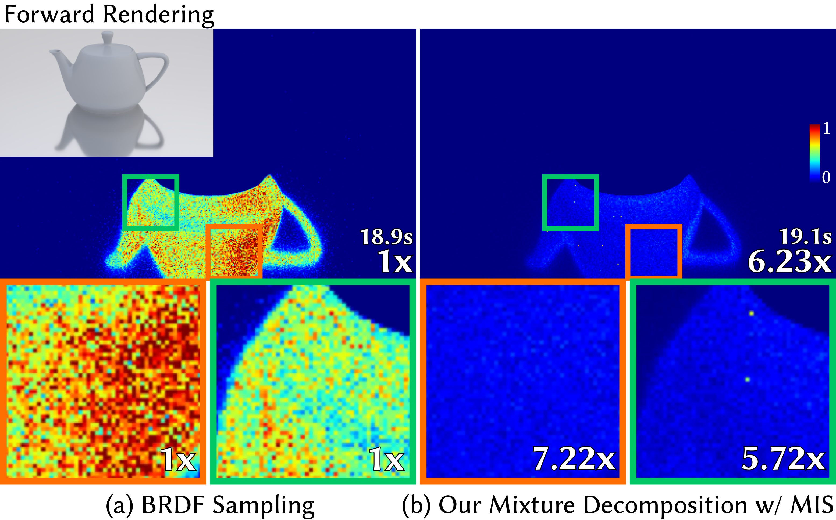
Mixture decomposition reduces variance of glossy reflections
Notes:
Here, we see that the mixture decomposition has significantly lower variance since it correctly handles the derivative’s sign.

Slide 44
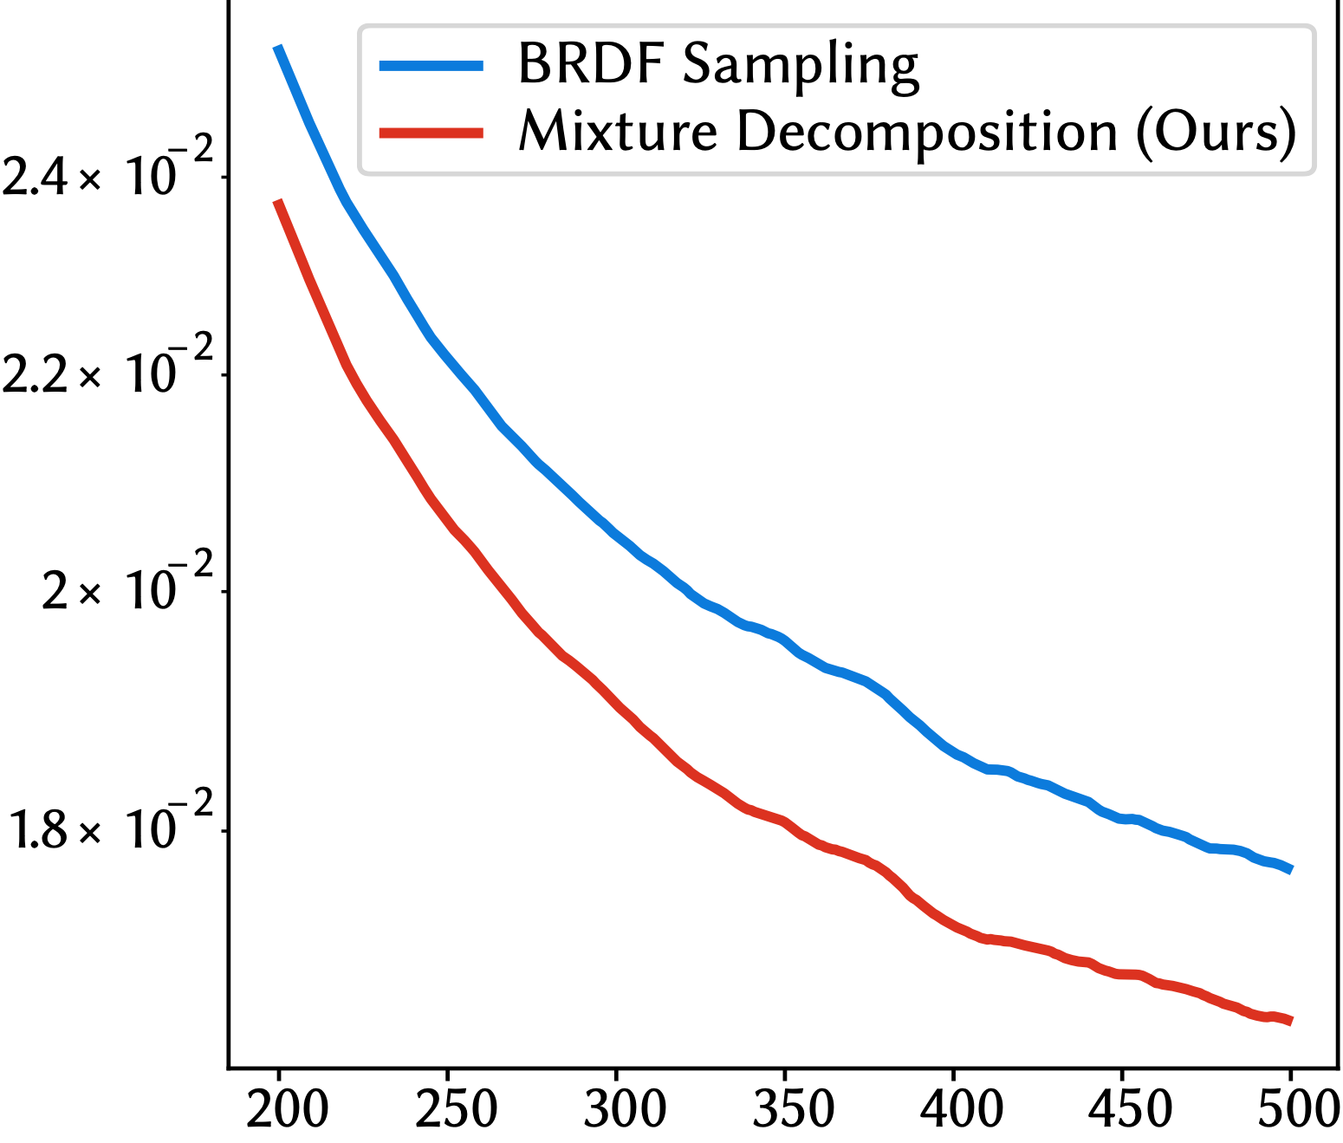
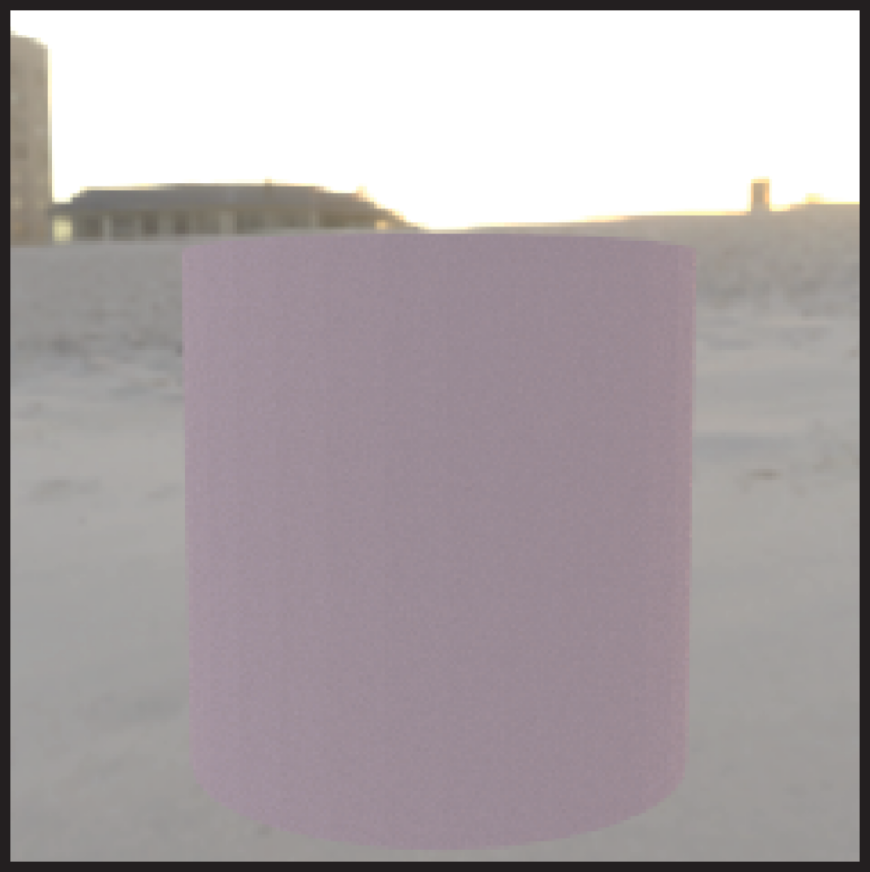
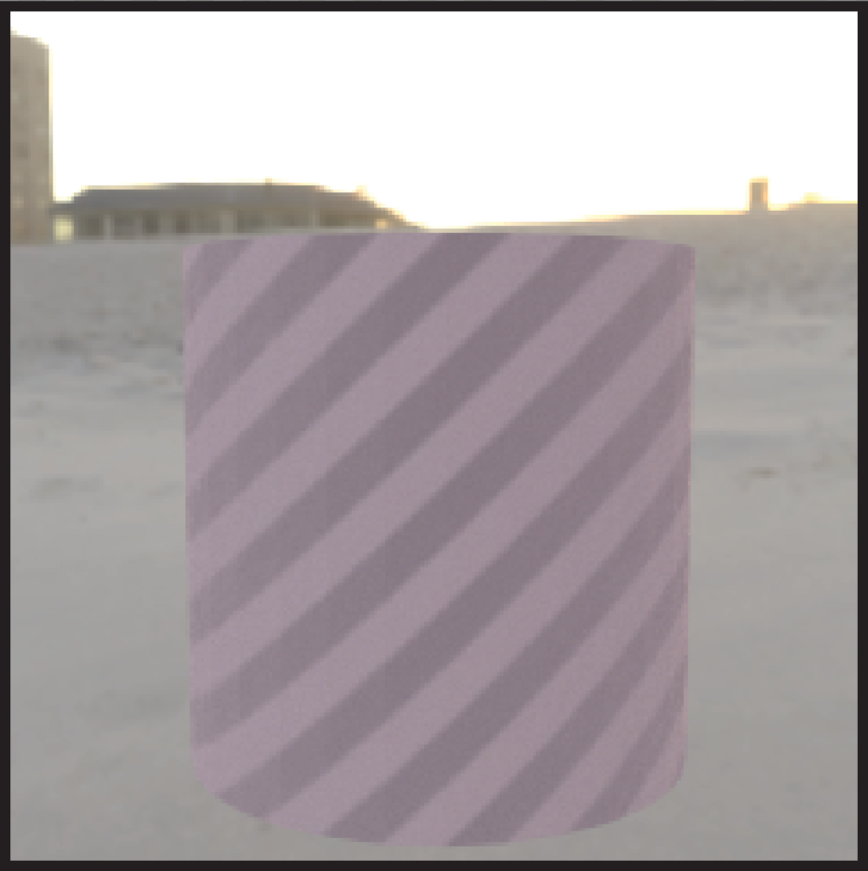
Mixture decomposition improves inverse rendering
loss
initialization
recovery
iterations
Notes:
Ultimately, we observe that reduced derivative variance leads to faster and higher quality inverse rendering.

Slide 45
Weights of mixture BRDFs
All layered BRDFs (Disney Principled, Autodesk Standard Surface, etc.)
Oren-Nayar
Microcylinder BRDF
and many others…
Our mixture decomposition
Notes:
This shows up whenever we’re differentiating a linear combination with respect to its weights like the ones above
Let’s now take a look at our final decomposition — the product decomposition.

Slide 46
Our product decomposition
$$g(x;α)=(2πα)^{-1}⋅e^{-\frac{x^{2}}{2α^{2}}}$$
$$e^{-\frac{x^{2}}{2α^{2}}}$$
$$(2πα)^{-1}$$
normalization: n
shape: h
Notes:
Several BRDFs can be written as a product of two terms— take for example this 1D Gaussian BRDF with standard deviation alpha — it is the product of a constant normalization term n and an exponential shape term h

Slide 47
Our product decomposition
$$h$$
$$∂_{α}g=∂_{α}(n⋅h)=f$$
$$n$$
Notes:
It’s derivative with alpha once again takes both positive and negative values.
Applying the product rule, we can separate this derivative into two terms

Slide 48
Our product decomposition
$$f=$$
$$n⋅∂_{α}h$$
$$+∂_{α}n⋅h$$
Notes:
The first term as you can see is all positive and the second term is all negative.
Once again, this is no coincidence — it follows naturally from the fact that the standard deviation alpha has the exact opposite effect on the two terms — for more details please see our paper.

Slide 49
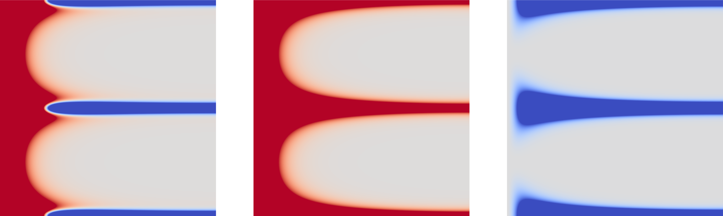
Product decomposition of anisotropic GGX derivative
$$θ$$
$$ϕ$$
$$f$$
$$n⋅∂_{α}h$$
$$+$$
$$∂_{α}n⋅h$$
$$=$$
Notes:
Using product decomposition, we are able to decompose the anisotropic ggx derivative that we weren’t able to positivize — all without ever having to find the derivative’s roots.
Let’s see some results.

Slide 50
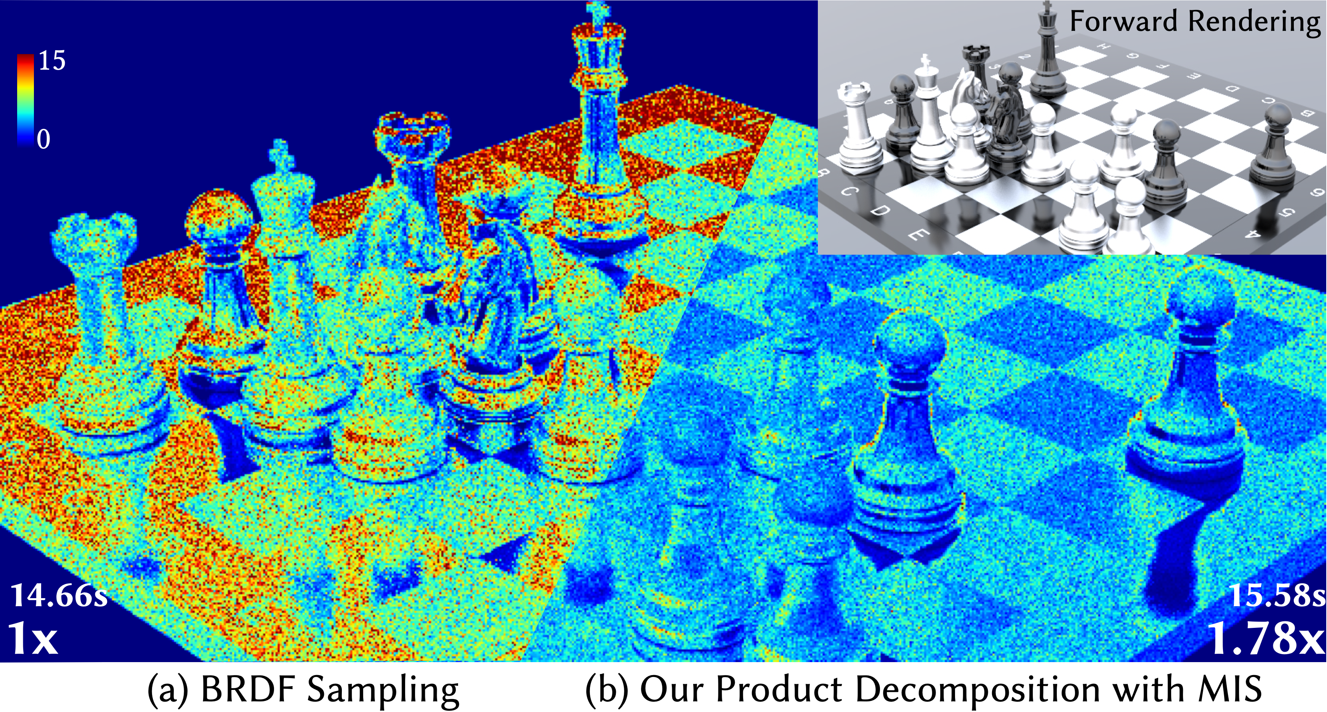
Product decomposition under global illumination
Notes:
Once again, due to the correct handling of sign variance, product decomposition has much lower variance than BRDF sampling

Slide 51
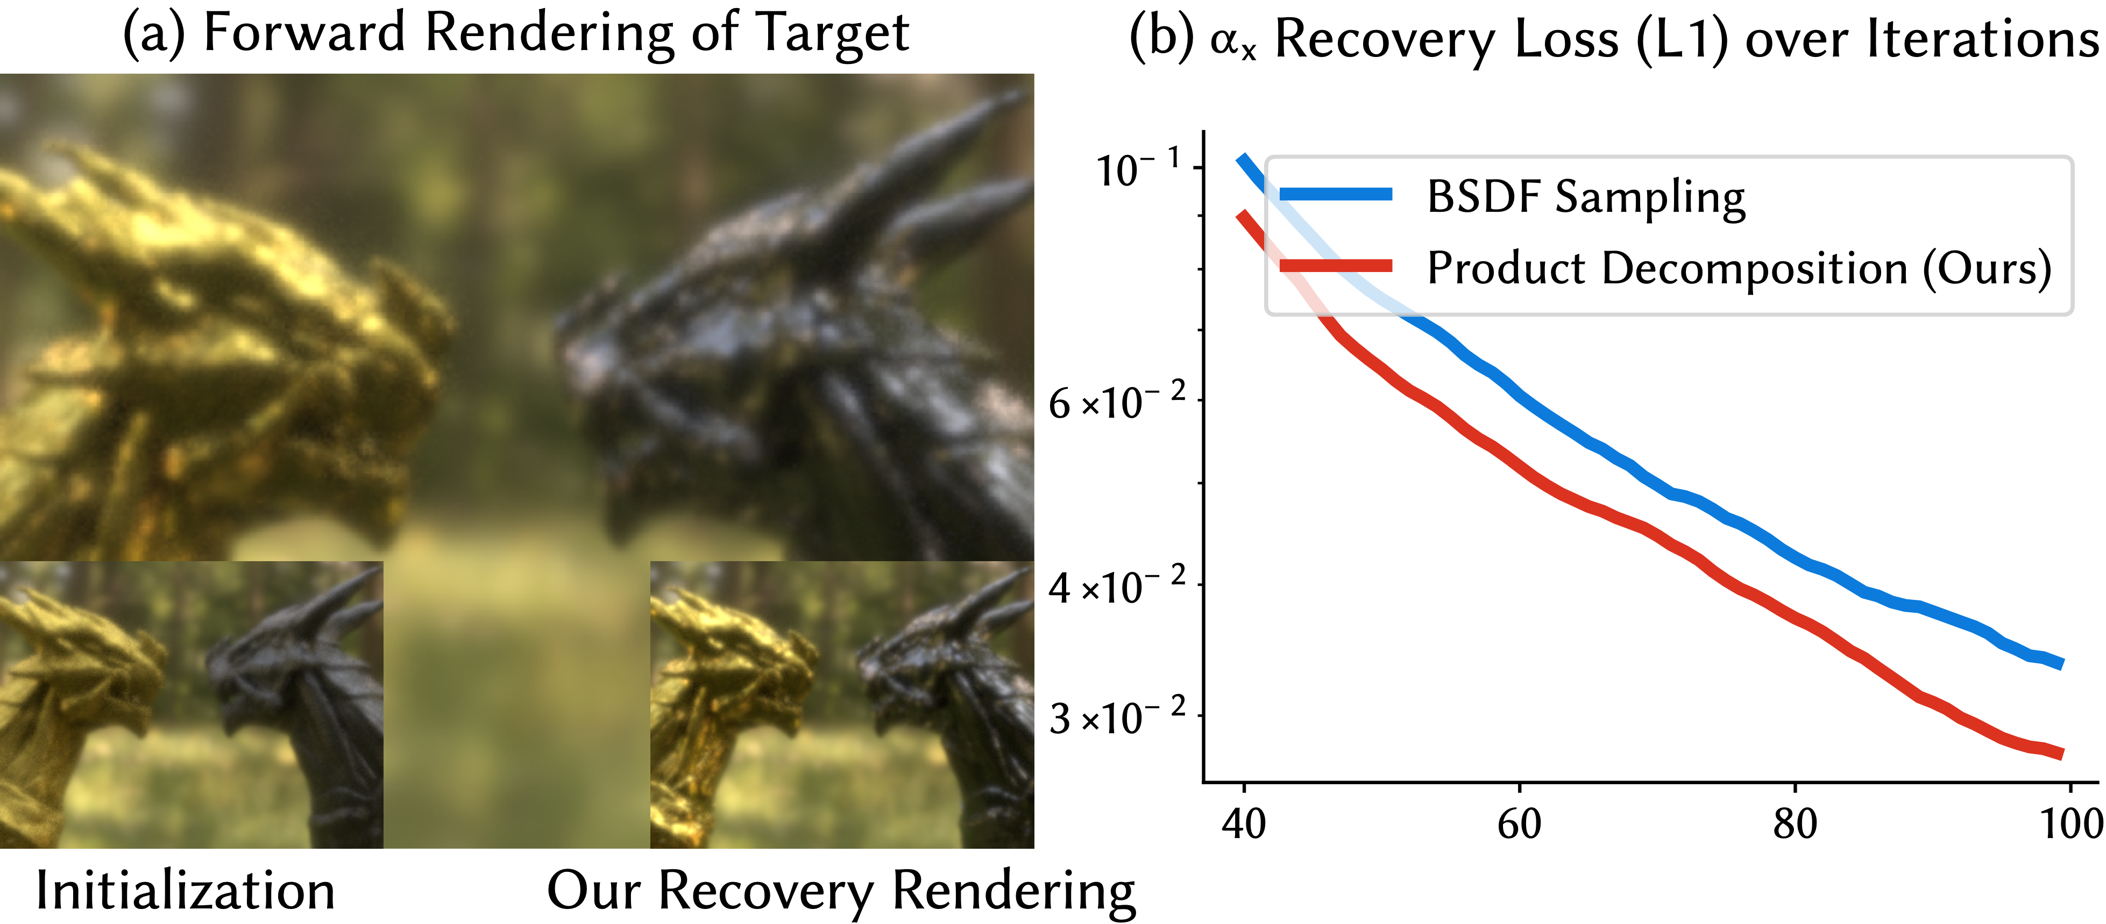
Product decomposition improves inverse rendering
Notes:
And this allows it to perform faster and higher quality inverse recovery.

Slide 52
Directional roughness of anisotropic Beckmann and GGX
Directional exponent of Ashikhmin-Shirley
Width of Burley’s BSSRDF
Our product decomposition
Notes:
Product decomposition allows us to importance sample several BRDFs that are written as a product of a shape term and a normalization term — with some listed above.

Slide 53
We now have good importance sampling techniques for BRDF in differentiable rendering
Notes:
I’d like to conclude by saying that we now have good importance sampling techniques for BRDFs in differentiable rendering and I can’t wait for you guys to try them out in your inverse rendering applications!

